Slide 1

Orientation
The Mekong School of Law
By: Dr. Vann Chandara, School Director
Phnom Penh, October 05, 2011

Slide 2
Content
Introduction
Objectives
School Leaders
Program Structures
Student’s Activities
What is Law?
Why Study Law?
Why Study Law at MSLAW?
Career Opportunities

Slide 3
Introduction
MSLAW is a part of Cambodian Mekong University.
MSLAW offers:
- Associate Degree (Law)
- Bachelor Degree (Law, Business Law, and Law in Human Rights)
- Master Degree (Law, Law in Human Rights)
- Doctoral Degree (Law)

Slide 4
Objectives
To make student understand the Cambodian Legal System and international Law.
To educate student through exposure to a variety of legal practice area and legal alternative options.
To make student develop skills necessary to effectively compete in the legal market and others.

Slide 5
Objectives (Cont)
To make students have the ability to analyze and examine the law cases.
To equip students with skills that would make student capable of analyzing and solving the legal problems.
To improve the ability of student in developing the law in society.

Slide 6
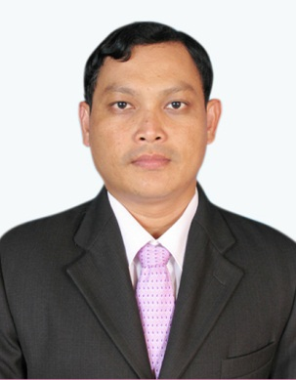


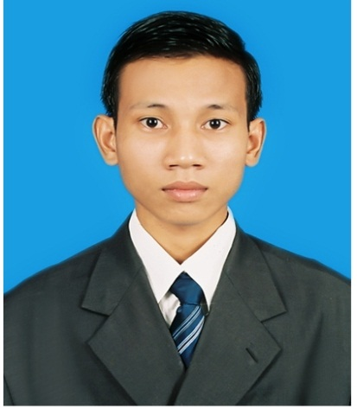
School Leaders
.
Dr. Vann Chandara,
PhD in Law
Director
070 230 555
Mr. Kao Muythong
Master of Law
Vice Director
067 345 543
Mr. Maosuy
Piseth
Master of Law
In charge of School Administration
093 678 988
Mr. Va Vanny
School Coordinator
098 741 126

Slide 7
Program Structures
Curriculum Structures | Credits
Foundation Courses | 30
General Courses | 15
Core and Major Required Courses | 54
Major Concentration Courses | 21
Elective Courses | 6
Total | 126

Slide 8
Foundation Courses
Semester I
Introduction to Human Communication
Introduction to Cambodian Law
Principle of Management
English Language Level 1
English Improvement 1
Computer Application 1A

Slide 9
Foundation Courses
Semester II
.
Public Administration and office management
Fundamental of Leadership
Organizational Behavior
Civil Law
Computer Application 2A
English Language Level 2
English Improvement 2

Slide 10
General Courses
English and Computer
English Language Level 3
English Language Level 4
English Language Level 5
English Language Level 6
English Language Level 7
Computer Applications 1-6

Slide 11
Core and Major Required Courses
Criminal Law
Special Criminal Law
Business Law I
Business Law II
Administrative Law
Intellectual Property Law
Civil Procedure Law
Criminal Procedure Law I
Criminal Procedure Law II

Slide 12
Core and Major Required Courses
Labor Law
Contract Law
International Relations
Public International Law
Private International Law
Land Law and &Urbanization
Tax Law
Diplomatic and Consular Laws
Human rights Law
Research Methods

Slide 13
Major Concentration Courses in Law
Major Concentration Courses in Law
Administrative Procedure
Special Contract law
Special Criminal Law
Family Law
Public Good Governance
Public Function Law

Slide 14
Major Concentration Courses in Business Law
Micro Economics
Principle of Accounting
Principle of Finance and Banking
Principle of Marketing
Laws of International Business Transaction
Alternative Dispute Resolution
Regulations on Securities Market

Slide 15
Major Concentration Courses in Human Rights
Mechanism for Protection and Promotion of Human Rights
Women and law
Children and Law
Civil and Political Rights
Economics, social and Cultural Rights
Migrant Worker and Law
Indigenous People and Law

Slide 16

Student’s Activities
Discussion Club
Annual Competition (Client Counseling, Mock Trial)
Seminars
Trips

Slide 17




Discussion Club

Slide 18
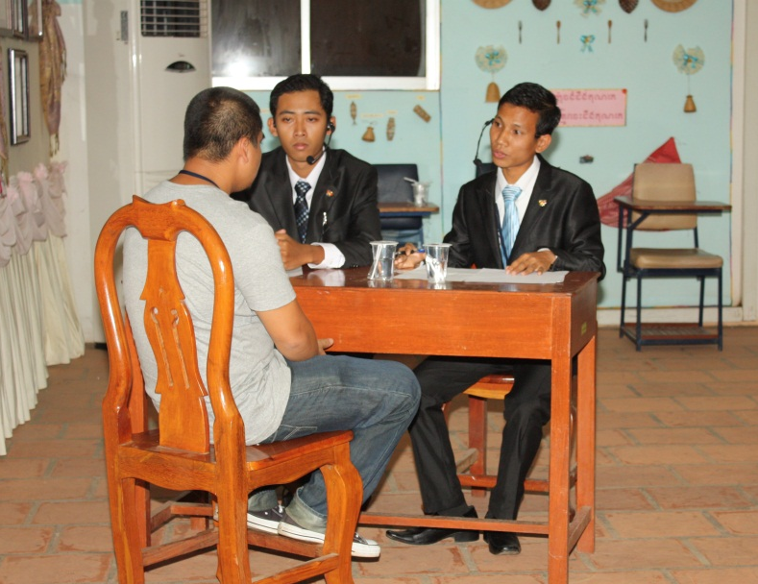
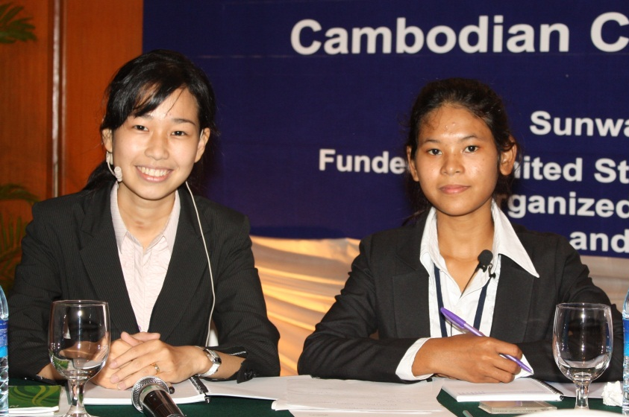
Annual Competitions
Client Counseling

Slide 19
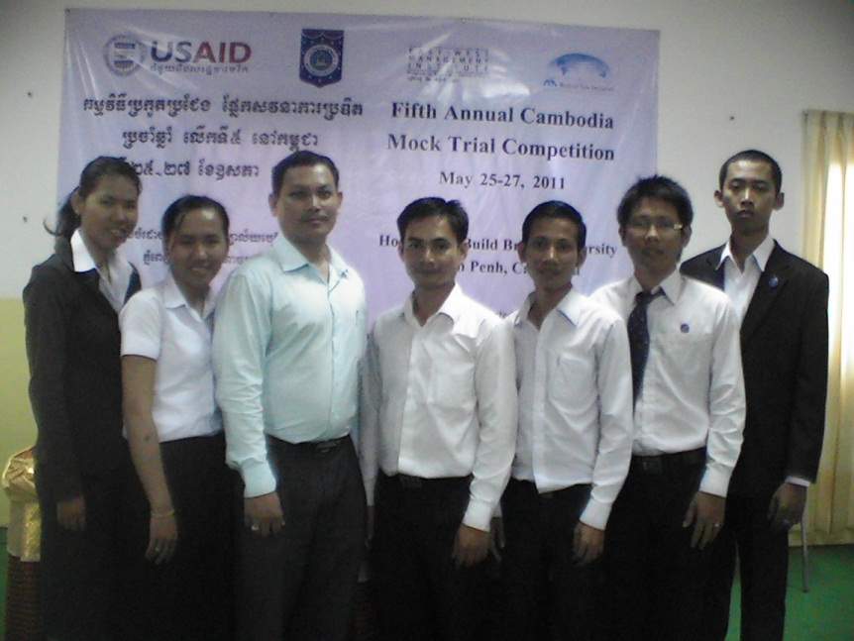
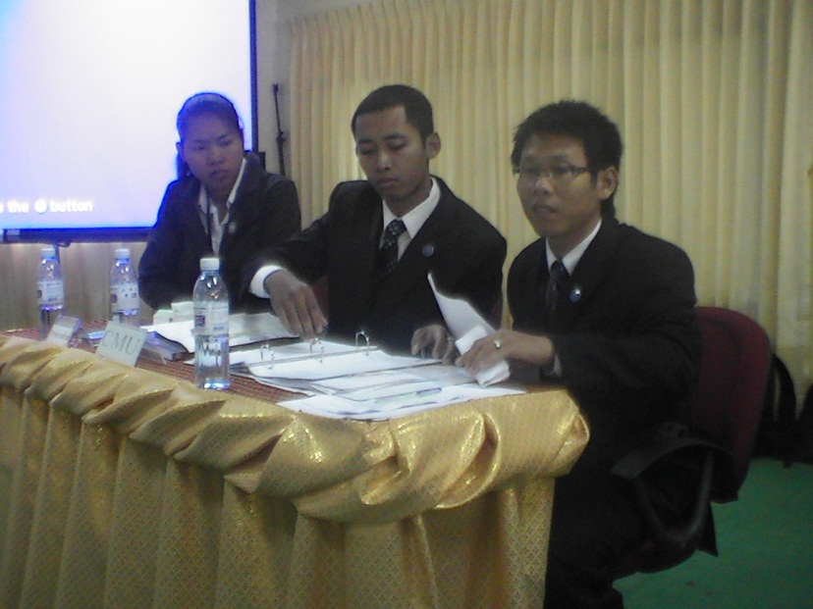
Annual Competitions
Mock Trial

Slide 20
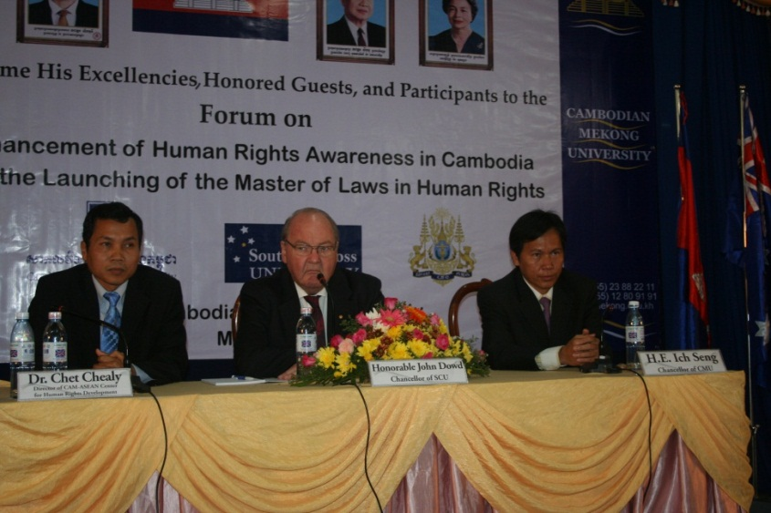
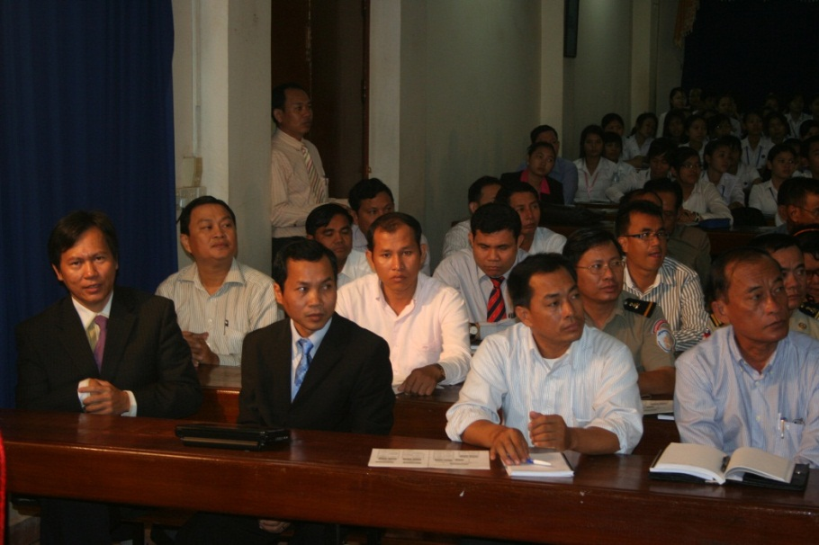
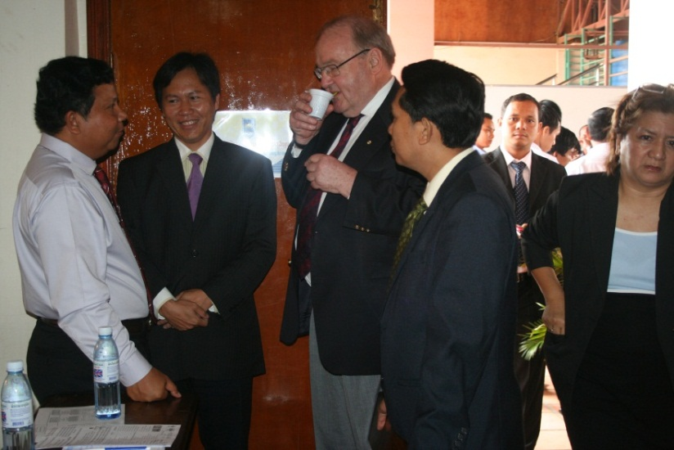
Seminars

Slide 21
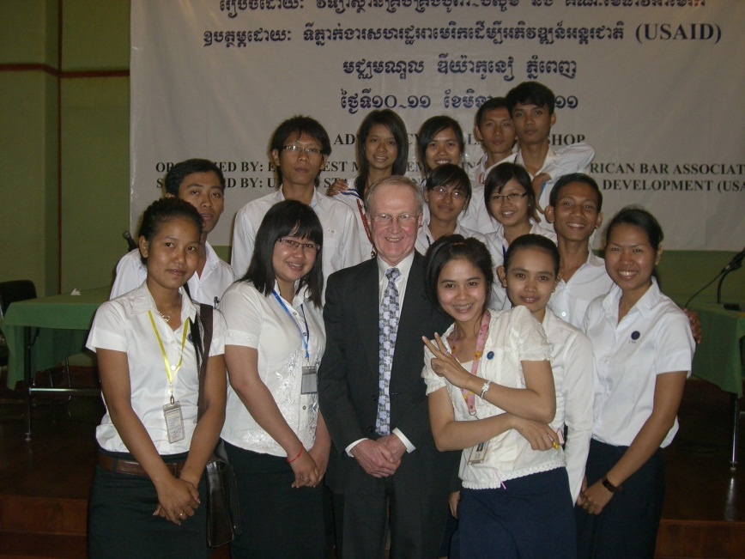
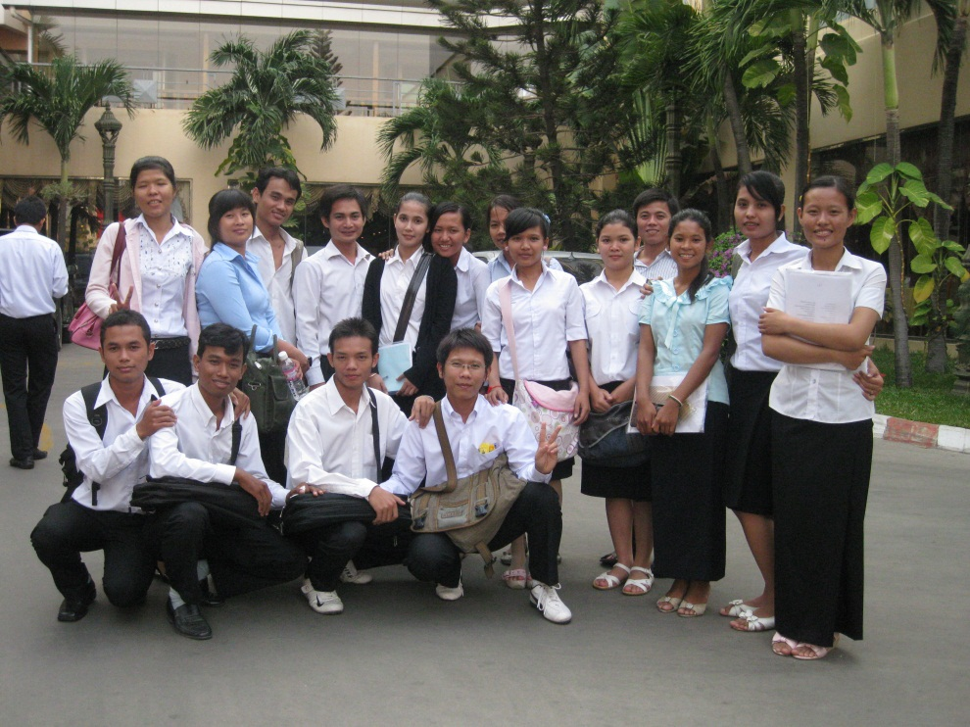
Trips

Slide 22
Why Study Law?
Because knowledge of law is empowering!
To help people and society
To change and develop the society
To get a good career or job
To challenge with others

Slide 23
Why Study Law at MSLAW?
Provide great knowledge of law and ability to deal with complex legal issues.
Provide students with extra class of general English, Computer Applications, and Entrepreneurship.
Our Law lecturers have great knowledge of law and high experience of law teaching and practice.

Slide 24
Why Study Law at MSLAW?
Offer a regular program of guest lectures such as seminar which presented by great and powerful speakers on key issues in law, international law, international relations, diplomatic and consular laws, political science, human rights, etc.
Provide student-counseling service.

Slide 25
Why Study Law at MSLAW?
Provide an opportunity for student do internship.
Provide student with values and ethics

Slide 26
Career Opportunities
Studying law offers you with wonderful career opportunities not only in legal practice but also in a very wide range of areas such as business, politics, international relations both public and private sectors.

Slide 27
Career Opportunities
Judge
Lawyer
Prosecutor
Diplomatic Official
Legal Officer
Notary Public
Bailiff
Court Clerk

Slide 28
Career Opportunities
Police Officer
Administrative Official
Legal Advisor
Lecturer of Law
Legal Assistant
Others…..

Slide 29
Career Opportunities
Which One Do You Want To Be?

Slide 30
Thank You!
Question and Answer!

